Slide 1
Introduction to Pandas and Jupyter
Lesson 4.1

Slide 2
Class Objectives
By the end of today’s class, you will be able to:
Serve Jupyter Notebook files from local directories and connect to their development environment.
Create Pandas DataFrames from scratch.
Run functions on Pandas DataFrames.
Read and write DataFrames to and from CSV files by using Pandas.

Slide 3
Introduction to Jupyter Notebook

Slide 4

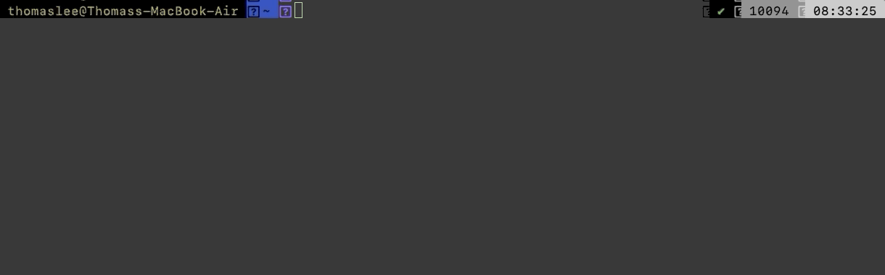
Introduction to Jupyter Notebook
Before diving into Pandas, let’s learn about Jupyter Notebook.
Jupyter Notebook is an open-source application that allows its users to create documents that contain live code, equations, visualizations, and explanatory text.
In other words, Jupyter Notebook combines a text editor, the console, and a markdown file into one application.

Slide 5
Connecting Jupyter Notebook to a Virtual Environment
Follow these steps:
Create a Python file with Jupyter Notebook. Set the kernel as ‘PythonData’.
Setting the kernel for Jupyter projects is important because these kernels let the program know which libraries are available for use.
Only those libraries loaded into the selected development environment can be used in a Jupyter Notebook project.

Slide 6
Introduction to Jupyter Notebook
Before diving into Pandas, let’s learn about Jupyter Notebook.
Understanding the structure of Jupyter Notebook files is key to navigation.
Each cell contains Python code that can be run independently by placing the cursor inside a cell and pressing Shift + Enter.
Jupyter notebooks allow users to experiment with code directly and save it for later.
The values in Jupyter notebooks are stored based on what lines of code were run last.

Slide 7
Activity: Comic Book Remix
In this activity, you will create a Jupyter notebook that performs the same functions as the Comic Book activity from the previous unit.
15 minutes

Slide 8
Activity: Comic Book Remix
Instructions | Using comicbooks.py as a starting point, convert the application so that it runs properly within a Jupyter notebook.
 | Have the application print out the user's input, the path to comic_books.csv, and the publisher/date published for the book in different cells.
Bonus | Go through any of the activities from last week, and convert them to run within a Jupyter notebook. As you go, try to split up the code into cells and print out the outputs.

Slide 10
Introduction to Pandas

Slide 11
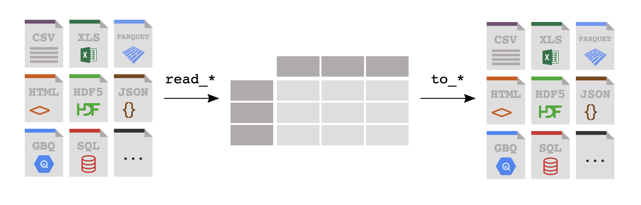
Introduction to Pandas
Modifying large datasets in Python can be challenging. Thankfully, the Pandas library is extremely powerful when it comes to visualizing, analyzing, and altering large datasets.
Pandas

Slide 12

Introduction to Pandas
Although Python alone is stuck using lists, tuples, and dictionaries, Pandas lets Python programmers work with Series and DataFrames. A DataFrame is a table with rows and columns. Each column in a DataFrame is a Series.
DataFrames Series
row
column

Slide 13
DataFrame Creation

Slide 14
DataFrame Creation
01
02
Import the Pandas library by using import pandas as pd. This method of import allows Pandas functions/methods to be called by using the variable pd.
To create a Series, run the pd.Series() function and place a list within the parentheses. The index for the values in the Series will be the numeric index of the initial list.

Slide 15
DataFrame Creation
03
04
One way (of many) to create DataFrames from scratch is to use the pd.DataFrame() function and provide it with a list of dictionaries. Each dictionary will represent a new row where the keys become column headers and the values are placed inside the table.
Another way to use the pd.DataFrame() function is to provide a dictionary of lists. The keys of the dictionary will be the column headers and the listed values will be placed into their respective rows.

Slide 16
Activity: DataFrame Shop
In this activity, you will create DataFrames from scratch by using the two methods just discussed.
15 minutes

Slide 17
Activity: DataFrame Shop
Instructions | Create a DataFrame for a frame shop. The DataFrame should contain three columns, "Frame", "Price", and "Sales", and have five rows of data stored within it.
 | Using an alternative method, create a DataFrame for an art gallery. The DataFrame should contain three columns, "Painting", "Price", and "Popularity", and have four rows of data stored within it.
Bonus | Once both DataFrames have been created, discuss which method you preferred and why.

Slide 19
DataFrame Functions

Slide 20
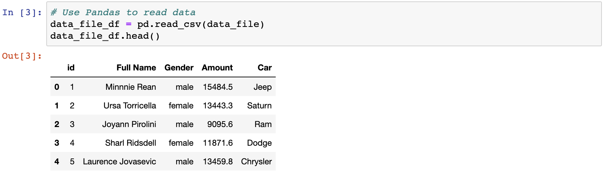
Built-In Pandas Function: head()
The head() method is helpful because it allows the programmer to view a minified version of a much larger table; then, they can make informed changes without searching through the entire dataset.

Slide 21
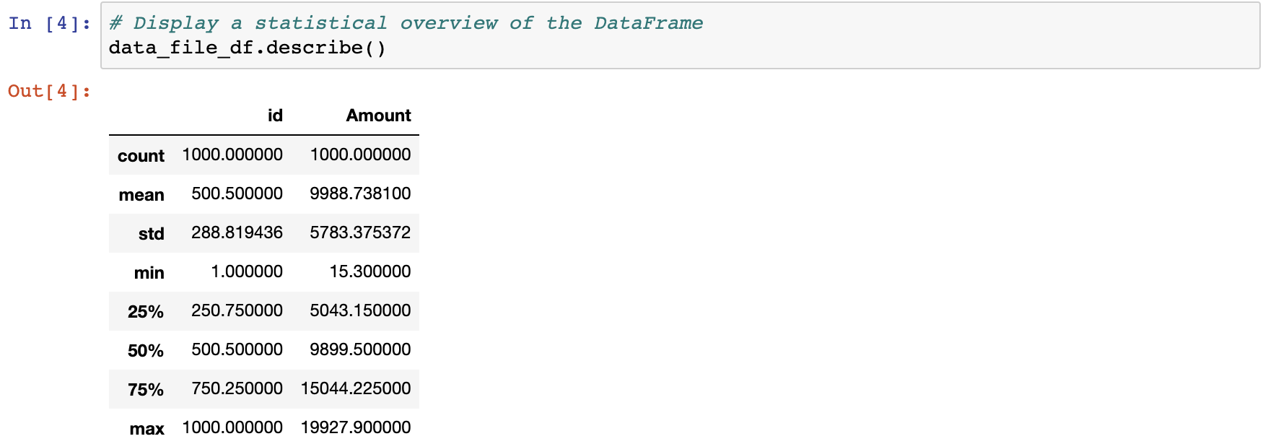
Built-In Pandas Function: describe()
The describe() method prints out a DataFrame containing some analysis of the table and its columns. It also indicates some of the other data functions can be performed on a DataFrame or Series.

Slide 22
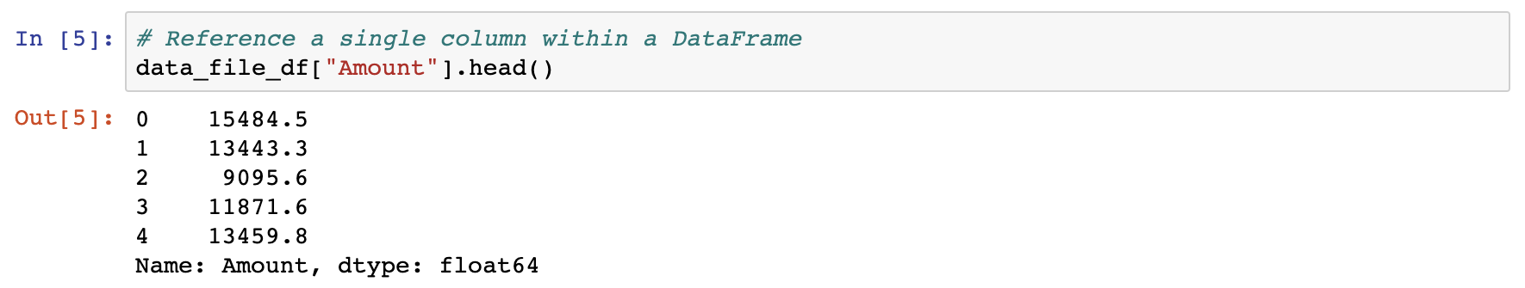
Working with a Single Column
Most data functions can also be performed on a Series by referencing a single column within the whole DataFrame.
Similar to referencing a key within a dictionary, take the DataFrame and follow it with brackets that contain the desired column's header.

Slide 23
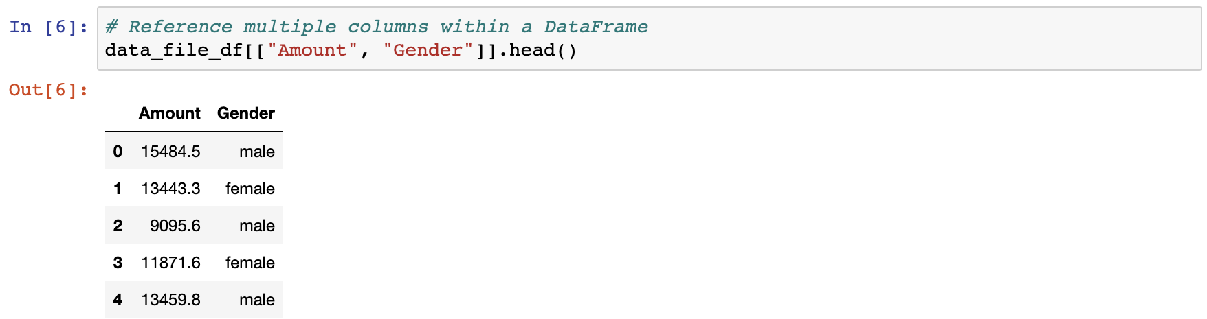
Working with Multiple Columns
Multiple columns can be referenced by placing all of the column headers desired within a pair of double brackets. If two sets of brackets are not used, then Pandas will return an error.

Slide 24
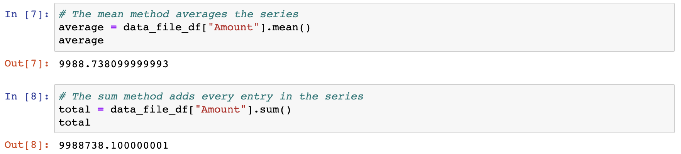
A Few Aggregating Functions
.mean() | computes the mean
.sum() | adds the values

Slide 25
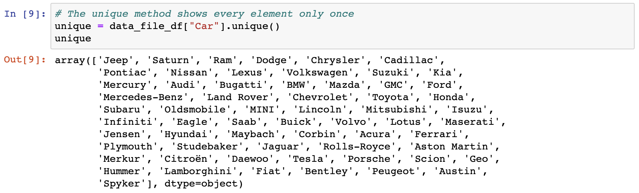
Built-In Pandas Function: unique()
In some situations, it’s helpful to list all of the unique values stored within a column. This is precisely what the unique() function does: it looks into a Series and returns all of the different values contained in it.

Slide 26
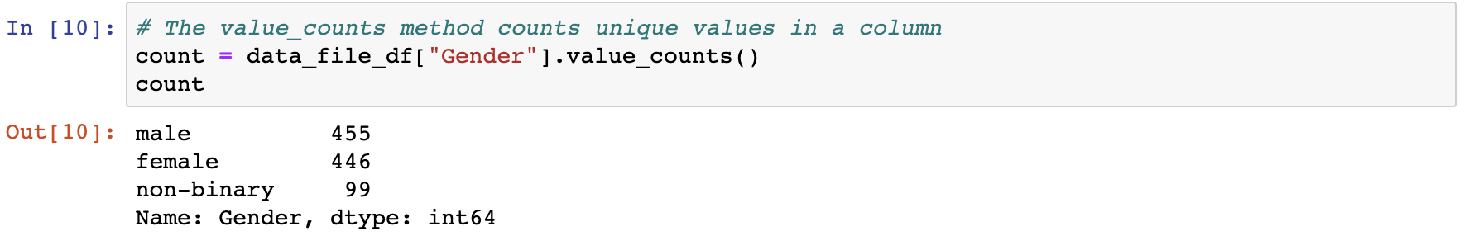
Built-In Pandas Function: value_counts()
Another method with similar functionality is value_counts(), which not only returns a list of all unique values within a Series, but also counts how many times a value appears.

Slide 27
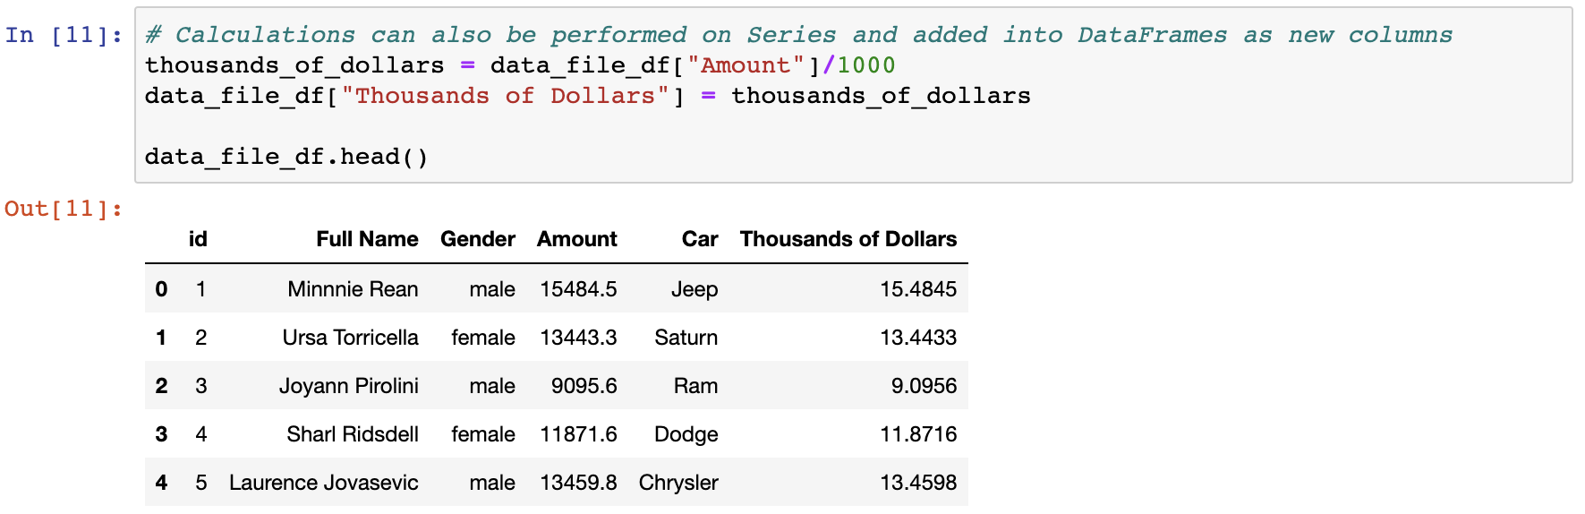
Beyond Pandas Visualization Power
Calculations can also be performed on columns and then added into the DataFrame as a new column. This is done by referencing the DataFrame, placing the desired column header within brackets, and then setting it equal to a Series.

Slide 28
Activity: Training Grounds
In this activity, you will now take a large DataFrame containing 200 rows, analyze it with data functions, and then add a new column into it.
15 minutes

Slide 29
Activity: Training Grounds
Using the DataFrame provided, perform all of the following actions:
Provide a simple analytical overview of the dataset's numeric columns.
Collect all of the names of the trainers within the dataset.
Figure out how many students each trainer has.
Find the average weight of the students at the gym.
Find the combined weight of all of the students at the gym.
Convert the "Membership (Days)" column into weeks, and then add this new Series into the DataFrame.

Slide 31
Modifying Columns

Slide 32
Modifying Columns
Column manipulation
An easy way to modify the names or placement of columns is to use the rename() function and double brackets.
To collect a list of all the columns contained within a DataFrame, use the 'df.columns' call, and an object containing the column headers will be printed to the screen.

Slide 33
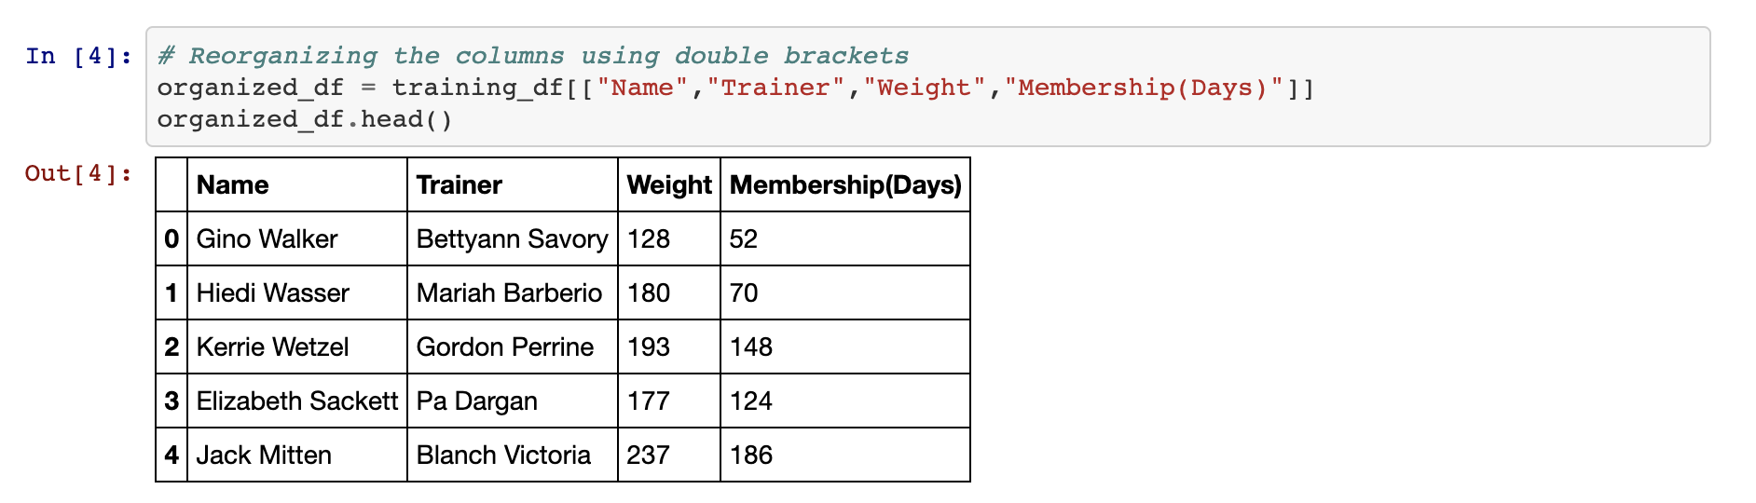
Modifying Columns
Column manipulation
To reorder the columns, create a reference to the DataFrame followed by two brackets with the column headers placed in the desired order.
It’s also possible to remove columns simply by not creating a reference to them. This will, in essence, drop them from the newly created DataFrame.

Slide 34
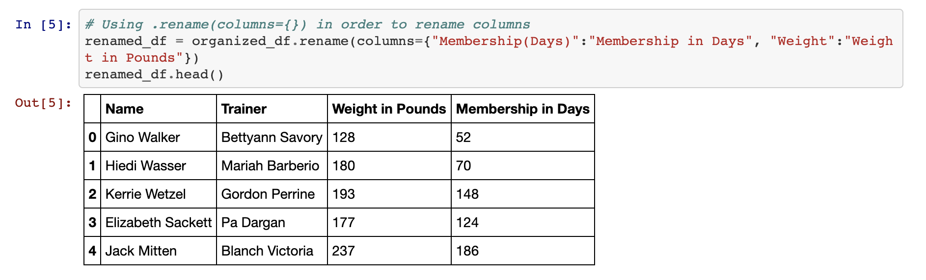
Modifying Columns
Column manipulation
To rename the columns within a DataFrame, use the df.rename() method and place columns={} within the parentheses.
Inside the dictionary, the keys should be references to the current columns, and the values should be the desired column names.

Slide 35
Activity: Hey Arnold!
In this activity, you will take a premade DataFrame of Hey Arnold! characters and reorganize it so that it’s easier to understand.
10 minutes

Slide 36
Activity: Hey Arnold!
First, use Pandas to create a DataFrame with the following columns and values:
Characters_in_show | Arnold, Gerald, Helga, Phoebe, Harold, Eugene.
color_of_hair | blonde, black, blonde, black, unknown, red.
Height | average, tallish, tallish, short, tall, short.
Football_Shaped_Head | True, False, False, False, False, False.
Note that the column names are inconsistent and difficult to work with. Rename them to the following, respectively:
Character, Hair Color, Height, Football Head
Next, create a new table that contains all of the columns in the following order:
Character, Football Head, Hair Color, Height

Slide 38

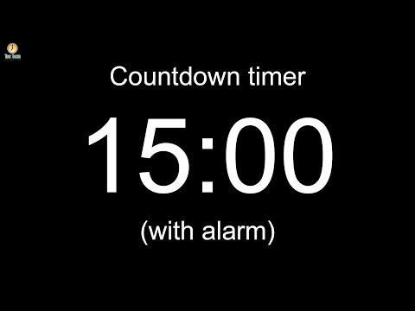
Notes:
-------------------
Image source: AdobeStock_56885471

Slide 39
Reading and Writing CSV Files

Slide 40
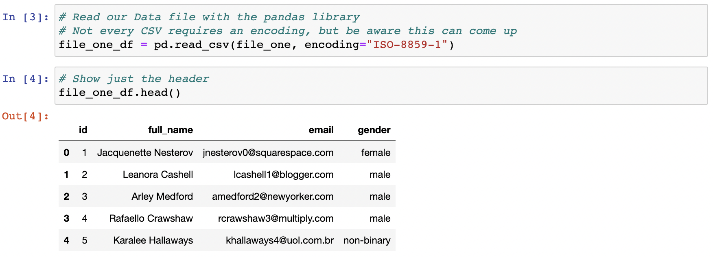
Reading and Writing CSV Files
A CSV file’s path is created and passed into the pd.read_csv() method, with the returned DataFrame stored within a variable.

Slide 41
Reading and Writing CSV Files
It’s just as easy to write to a CSV file as it is to read from one.
Simply use the df.to_csv() method, and pass the path to the desired output file. By using the index and header parameters, programmers can also choose whether they would like the index or header for the table to be passed as well.

Slide 42
Activity: Comic Books Part 1
In this activity, you will take a large CSV file containing comic books, read it into Jupyter Notebook by using Pandas, clean up the columns, and then write a modified DataFrame to a new CSV file.
20 minutes

Slide 43
Activity: Comic Books Part 1
Instructions | Read in the comic books CSV by using Pandas.
 | Remove unnecessary columns from the DataFrame so that only the following columns remain: ISBN, Title, Other titles, Name, All names, Country of publication, Place of publication, Publisher, and Date of publication
 | Rename the Name column to Author, rename the Date of publication to Publication Year, and then apply title case styling where appropriate in the remaining columns
 | Write the DataFrame to a new CSV file.
Hint | The base CSV file uses UTF-8 encoding. Trying to read in the file by using another kind of encoding could introduce strange characters to the dataset.

Slide 45
Activity: Comic Books Part 2
In this activity, you will take the modified version of the comic book DataFrame and create a new summary DataFrame based on that dataset, using some of Pandas’ built-in data functions.
20 minutes

Slide 46
Activity: Comic Books Part 2
Using the modified DataFrame that was created earlier, create a summary table for the dataset that includes the following pieces of information:
The count of unique authors within the DataFrame
The count of unique countries of publication within the DataFrame
The year of the earliest published book in the DataFrame
The year of the latest published book in the DataFrame

